Slide 1

CS422 Data Mining Project
Predicting Electricity Consumption Based on Weather
Using
Machine Learning
Chenglin Liu
2025.5.30

Slide 2
CS422 Data Mining Project
What are we solving?
In an era where service availability demands are ever-increasing, continuous cloud data-center uptime is paramount.
Hardware, power supplies, HVAC systems, and all supporting infrastructure must run at peak efficiency to deliver predictable availability, achieve near-zero downtime, or ensure any outages remain completely transparent to end users.

Slide 3
Significance of the Study
CS422 Data Mining Project
CS422 Data Mining Project
Inaccurate load predictions can cause energy waste, blackouts, or increased operational costs.
Weather factors such as temperature, humidity, and wind significantly influence electricity consumption patterns.
Accurate forecasts contribute to optimizing energy production, cost savings, and sustainability goals.
Enables better adaptation to climate variability and integration of renewable energy sources.
Chenglin Liu
2025.5.30

Slide 4
CS422 Data Mining Project
Methodology Summary
Data preprocessing: cleaning, imputation, and feature extraction including rolling statistics and lagged features.
Engineering complex weather-related and temporal features to capture nonlinear effects.
Comparing classic linear regression with ensemble models, emphasizing Random Forest.
Time series-aware model validation and hyperparameter tuning via grid search.
Comprehensive exploratory data analysis to understand data patterns and model behavior.
Evaluation using regression metrics and a load classification approach for anomaly detection.

Slide 5
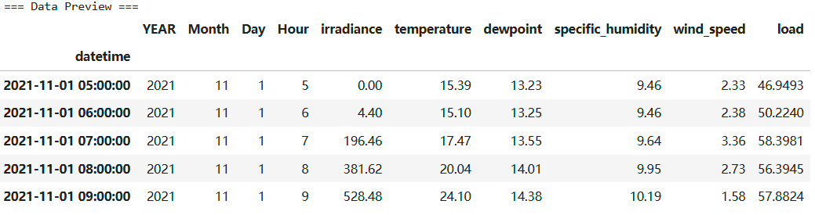
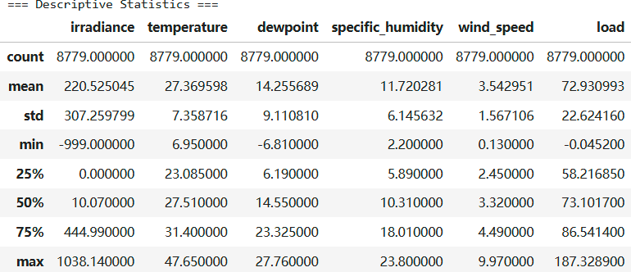
CS422 Data Mining Project
Data Preparation

Slide 6
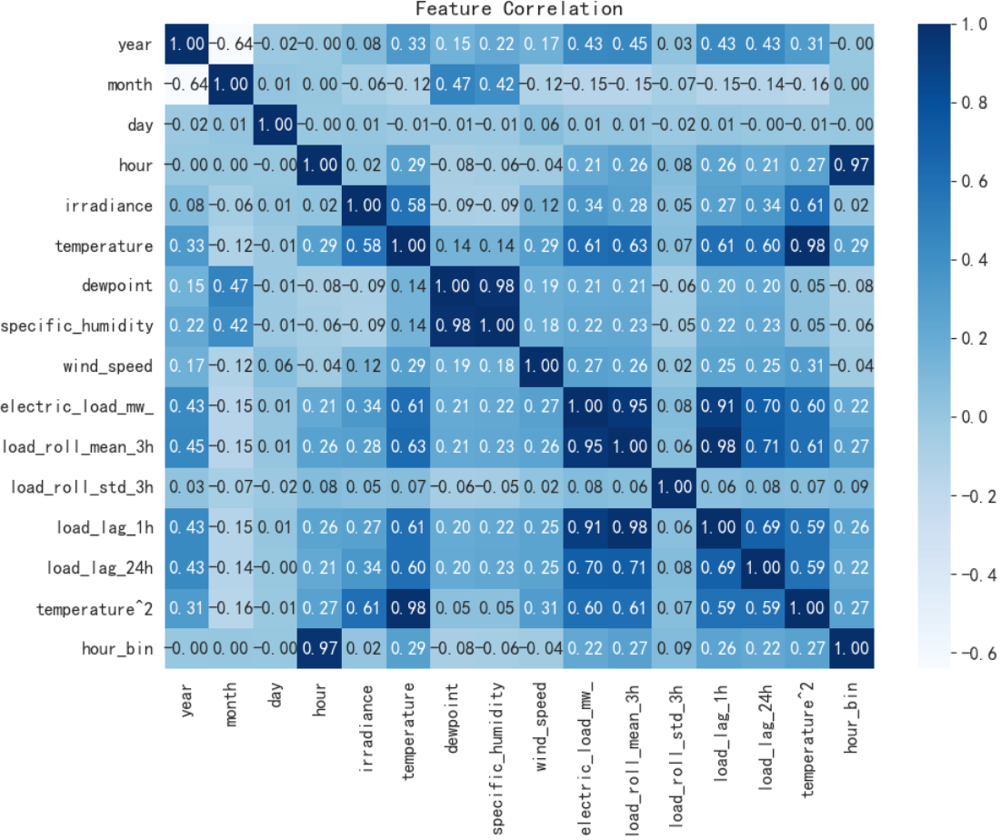
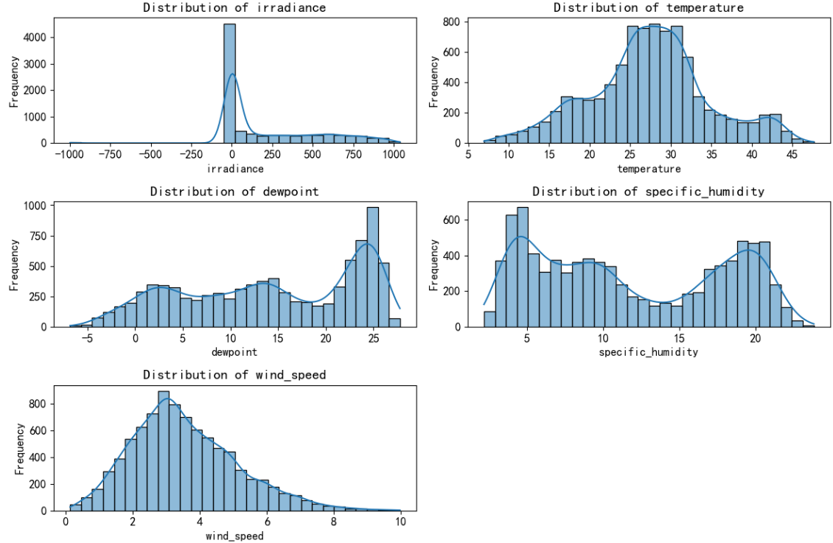
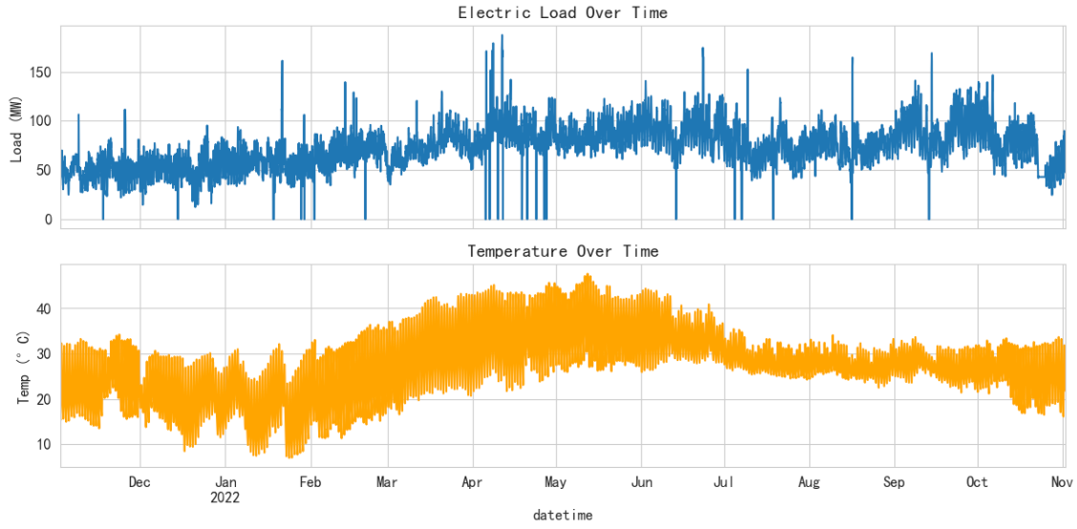
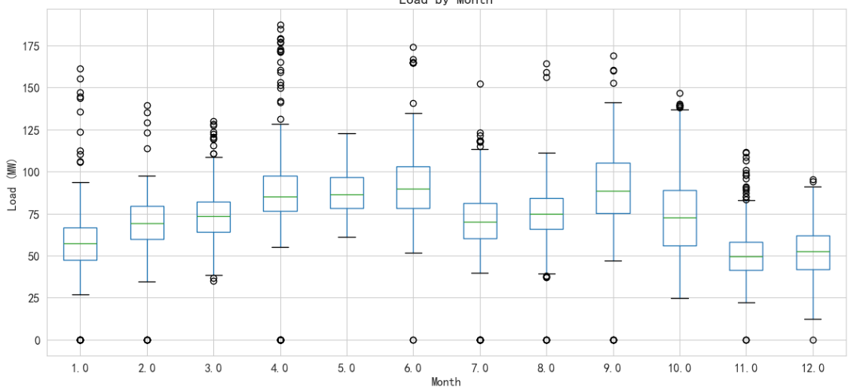
CS422 Data Mining Project
Exploratory Insights

Slide 7
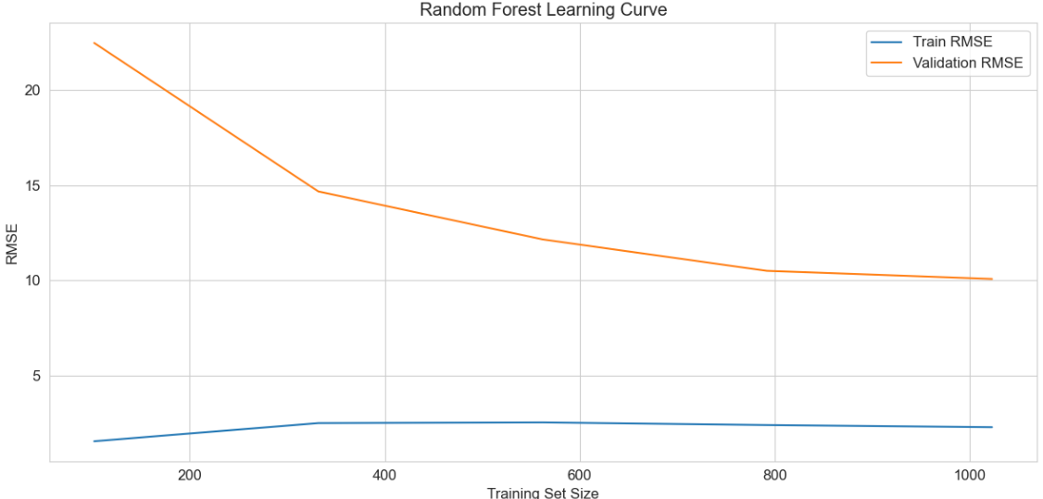
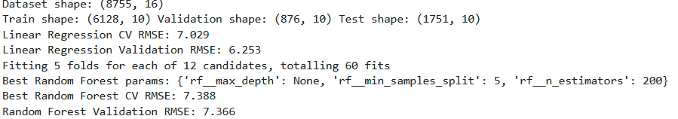
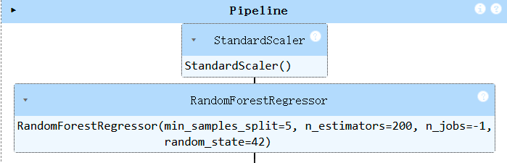
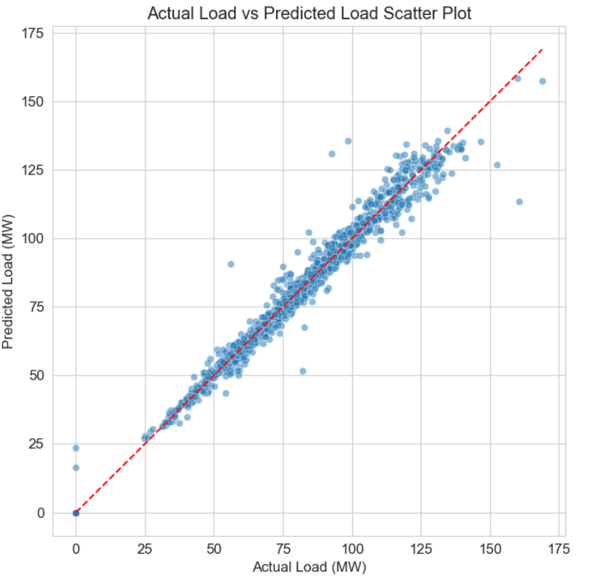
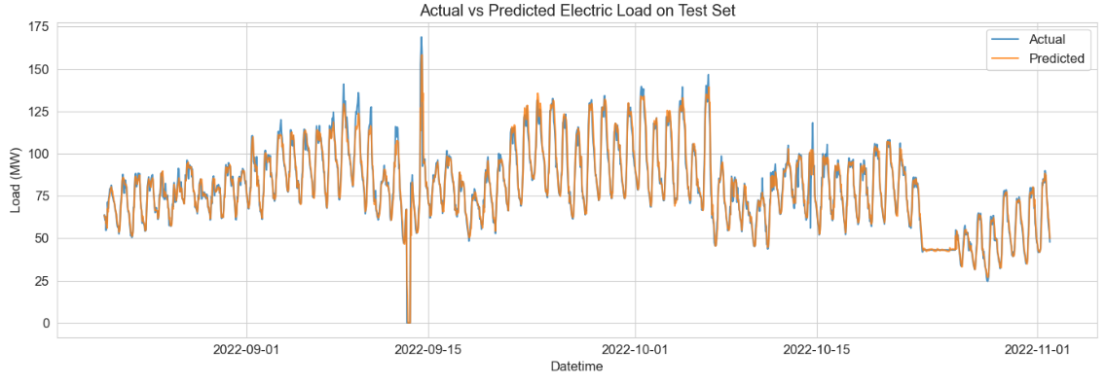
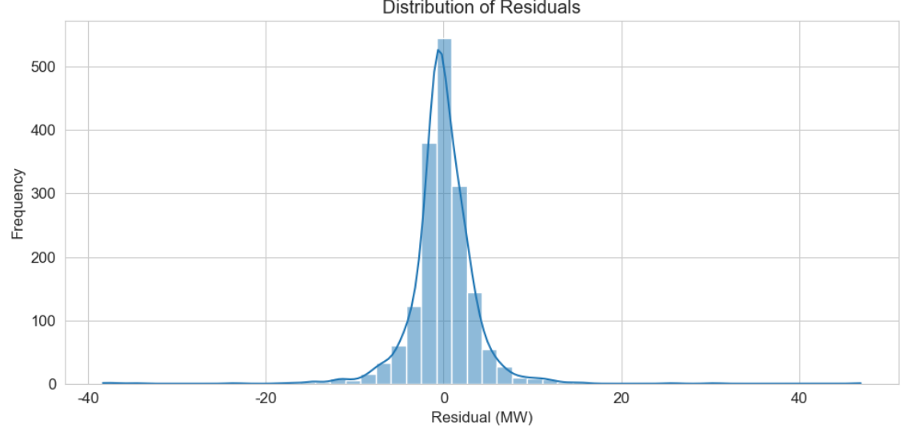
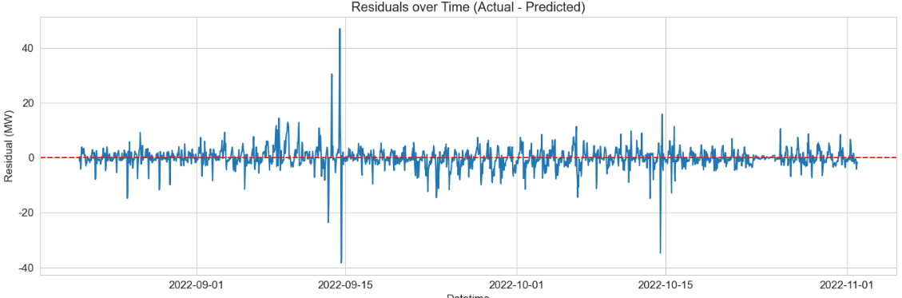
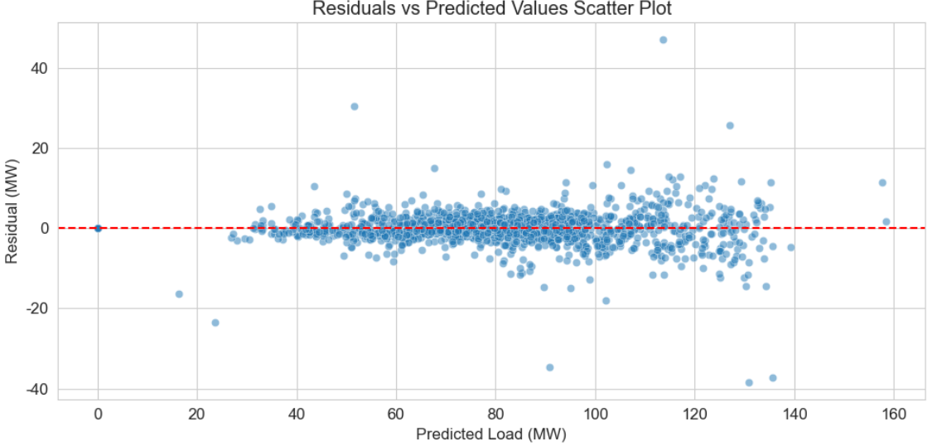
CS422 Data Mining Project
Modeling and Hyperparameter Optimization

Slide 8
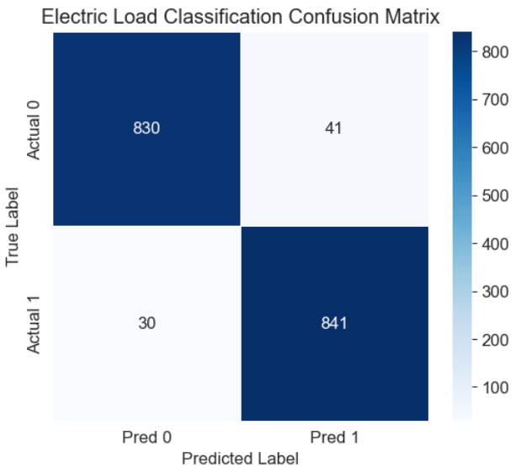
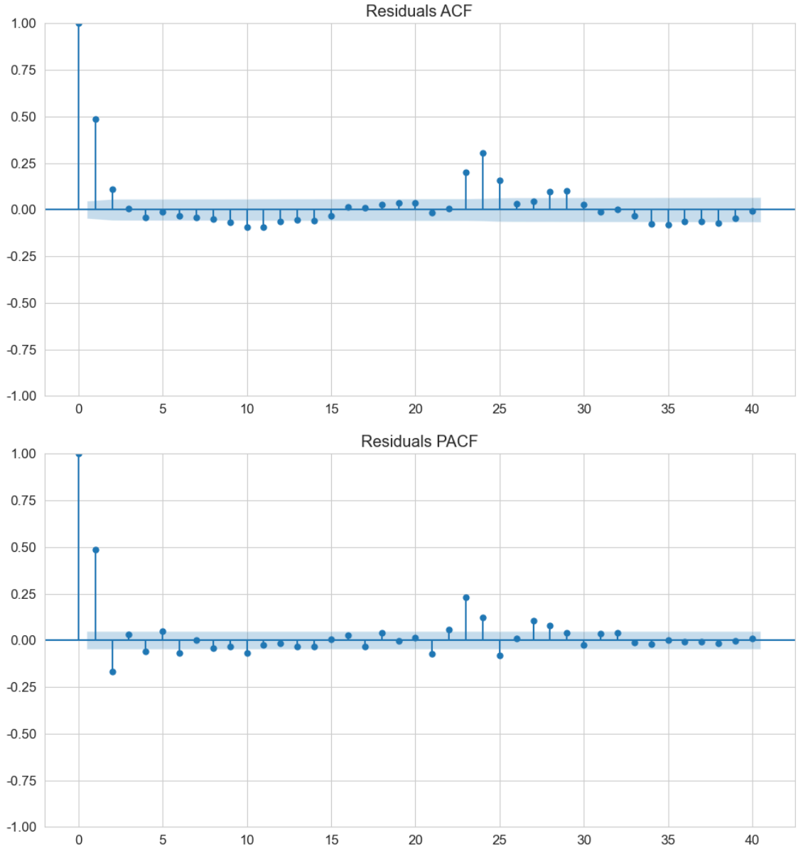
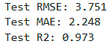
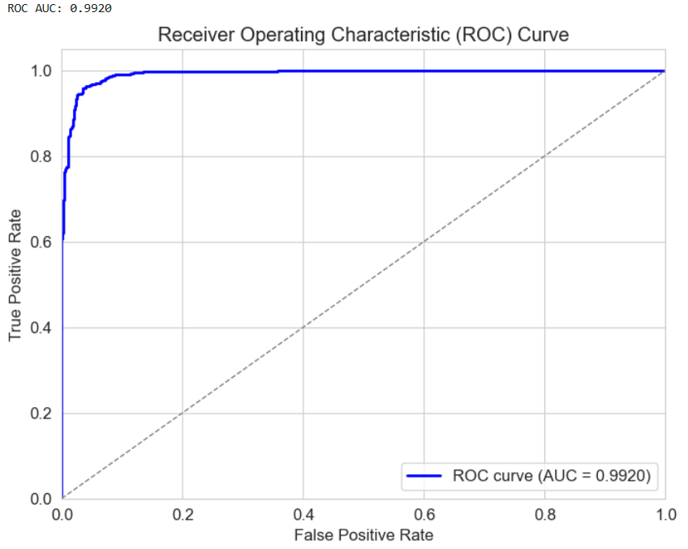
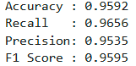
CS422 Data Mining Project
Load Classification and Evaluation

Slide 9
CS422 Data Mining Project
Conclusions and Future Direction
Integrating multiple meteorological factors enhances electric load forecasting quality.
Random Forest models capture complex nonlinearities better than linear models.
Binary classification framework adds practical value for load anomaly detection.
Future work: incorporate higher resolution weather data, explore deep learning approaches, and develop real-time predictive systems.

